Slide 1

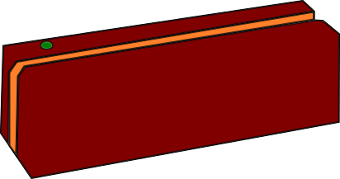
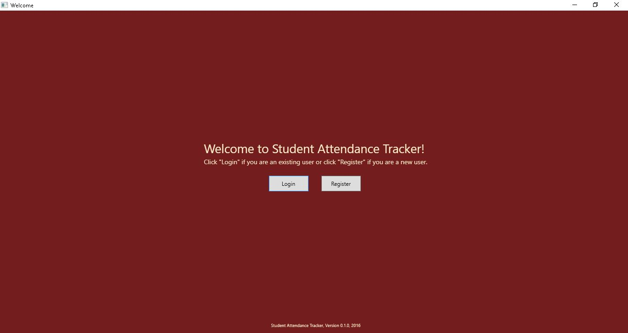
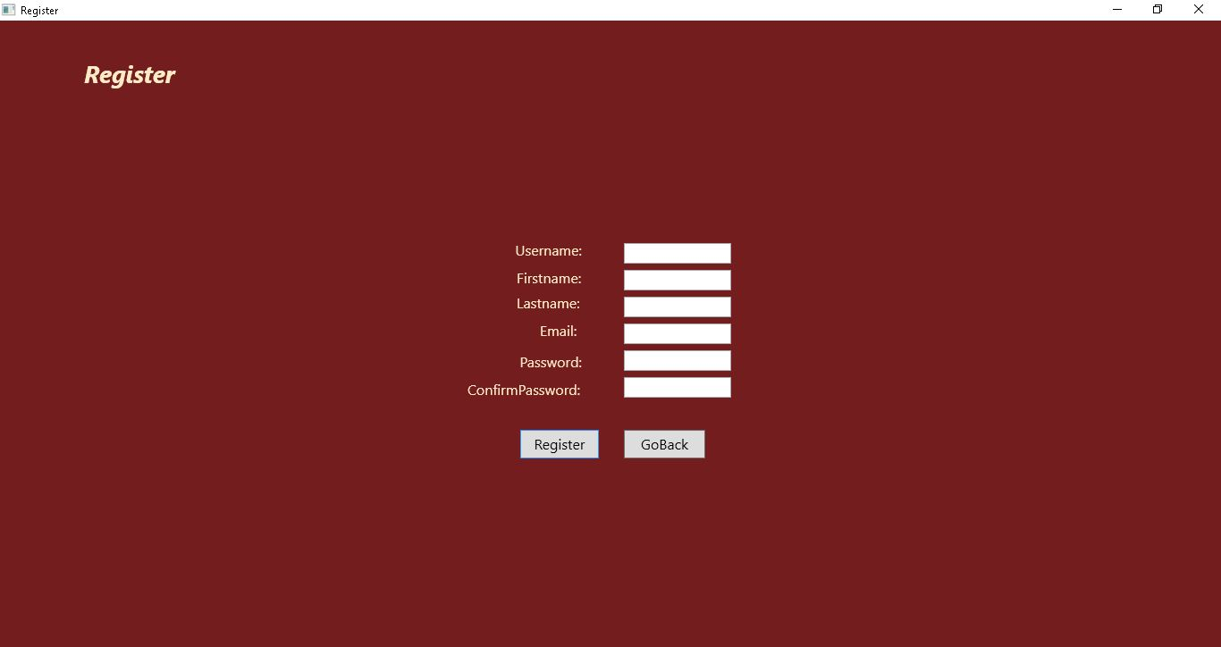
Creating a Student Attendance Tracker that Utilizes a Magnetic Stripe Card Reader
Austin Bower, Matt Rawson, Zachary Minnix, Harold Smith, Yingjun Liao
Abstract
A major problem many students and professors currently have is the time and resource intensive process of taking attendance. At the start of every class period the professor has to either pass around a roll sheet (which is distracting to the students) or do a roll call (which takes up class time). In order to alleviate this problem we have developed software that will allow students to swipe their student ID card through a magnetic stripe card reader which will record their attendance for that class that day. This will allow attendance to be taken before class even begins without the need for a roll call or roll sheet. Our software was written in the C# programming language via the Microsoft Visual Studio 2015 development tool under the Microsoft .NET framework and environment. Additionally, we utilized the SQL Server 2014 for the database development.
Problems and Difficulties
Just like any big project in any field, ours saw its fair share of problems and difficulties. Here are a few of the significant problems that we ran into and a look at how we tried to address them:
User Interface (UI) complexity: Our original plans called for a more complex and intuitive/user friendly interface. However, as we ran into trouble implementing some of these features we decided that we would have to simplify some of the UI features. Despite our compromises we still maintained our focus on an easy to use UI.
Database implementation: Although we have made significant gains since we started the project, utilizing a database for the system proved to be a time consuming task. The reason so is that much of the group had little to no prior experience with databases. However, we saw this as a learning experience. Although we have yet to fully integrate our database into the project, we believe that we will have full integration in the very near future.
Utilizing version control software: Version control software is software that allows many people to work on a project at the same and keeps everyone up to date. We utilized GitHub for version control. Despite our previous experience with the software, we had some issues with merge conflicts. Since Visual Studio projects generate so many files that are altered under the hood it can be difficult to figure out how to address these conflicts. However, the more we used it and the more familiar we became with it the better we got at resolving the issues that were slowing us down before.
(Picture 1 – Welcome Screen)
How Does it Work?
When the professor first starts up the software they will be greeted with the welcome screen (seen right, picture 1). If they have already registered an account with the system they can proceed to the login screen. Otherwise they will need to create an account (seen right, picture 2). From their home screen professors will have the options to add courses, take attendance, and edit attendance. The utility and features of each are as follows:
Add courses: From the add courses menu the professor will have the ability to create new courses to track attendance for as well as remove existing courses that they no longer wish to track attendance for. The professor will also be able to add or remove students from existing courses.
Take attendance: From the take attendance menu the professor will choose which class they wish for attendance to be taken and then the system will be ready for students to swipe their student ID cards. The system will check to see if the card that was swiped belongs to a student that is in the class selected. If so, that student will be marked as present for the day and success message will appear. If not, an error message will display. The only way for the system to return to the professor’s home screen is for them to re-enter their login credentials. This helps to ensure only the professor has access to other information.
Edit attendance: From the edit attendance menu the professor will have the ability to lookup students from any of their registered courses and look at/edit the attendance records for any given student. This will allow professors to go back and check attendance as well as allow them to alter the attendance for students whose abscence(s) the professor wishes to excuse.
Future Work
Looking back at the project one thing that is obvious is that time was not on our side. As a result we had to make some concessions and reduce or eliminate some features. Some things we would like to add or improve in the future include:
Improvements to the UI
(Picture 2 – Professor Register Screen)

